Slide 1

Smart Bike Helmet
Crash Detection and Sustainability Goals

Slide 2
Cyclists are vulnerable to road accidents; timely response can save lives
A smart helmet with crash detection and alert capabilities.

Slide 3
UN sustainability development goals (SDGs) Alignment
Goal 3: Good Health and Well-being
Reducing injuries and fatalities by alerting on scene emergency response to forces being over the limit for safety and promoting bike safety.
Goal 9: Industry, Innovation, and Infrastructure
Utilizes innovative technologies for personal safety.
Can integrate with smart cities for data sharing.
Goal 11: Sustainable Cities and Communities
Encourages safe cycling, reducing congestion and pollution.
Goal 13: Climate Action
Promotes cycling as a sustainability, low-carbon transport option.

Slide 4
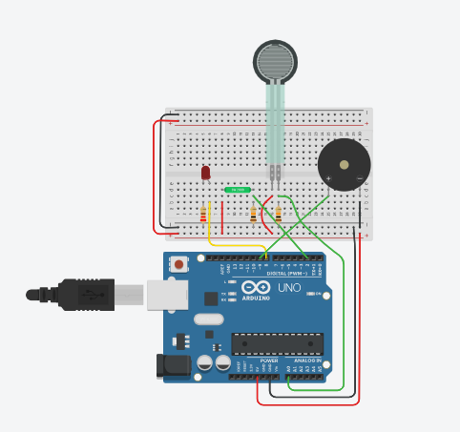
How the Circuit Works
Components:
Force Sensitive Resistor (FSR): Detects impact force.
Arduino: Process the signal and triggers responses.
LED: Provides visual alerts
Piezo Buzzer: Emits audible alerts.
Process:
Detect impact -> Measure Force -> Activate Alert System (LED/Buzzer)

Slide 5
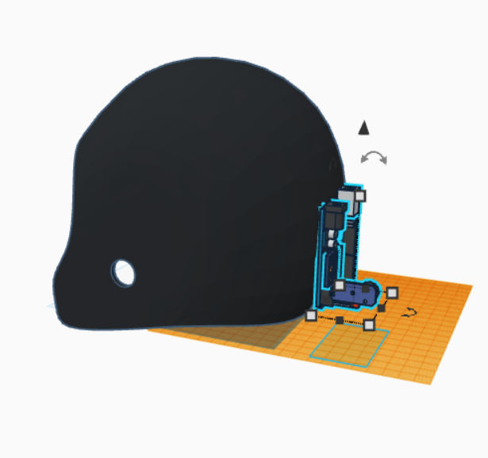
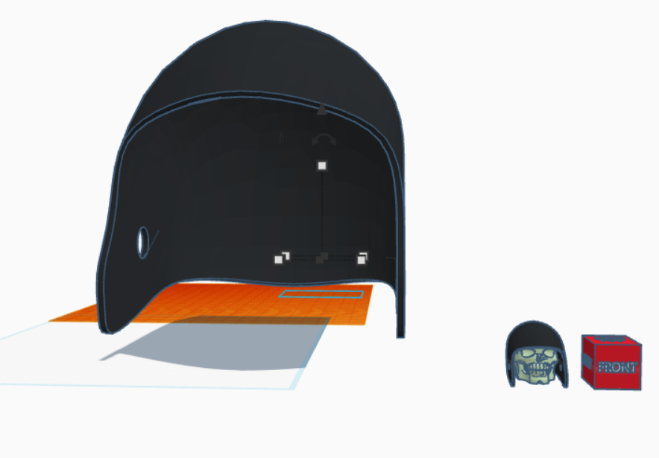
Helmet Intergration
Best Placement for the Circuit:
Rear or side sections (Less impact-prone)
Embedded in helmet foam for protection
Option for detachable module for added safety
Future Design Considerations
Waterproofing and shock-resistant casing
Lightweight materials to ensure comfort
All wire routing through helmet grooves for safety and durability

Slide 6
Features for future development
Crash Detection and Alerts
Threshold calibrations to differentiate crashes from minor bumps
GPS module to send location to emergency contacts
Bluetooth/GSM integration for alerts
Health Monitoring
Add sensors to track vitals like heartrate post-crash
Data Logging
SD card module for storing impact data for analysis
Sustainability Features
Eco-Friendly materials
Solar-powered rechargeable batteries

Slide 7
Broader Impact
Cycling Safety Awareness
Promotes Cycling as a safer transportation mode.
Smart Cities and Connectivity
Integrate helmets with urban traffic management systems
Scalability and Accessibility
Ensure Affordability for wider adoption, especially in low-income areas

Slide 8
Conclusion
Key Takeaways
Smart helmets will be able to enhance safety, promote sustainability, and align with global goals.
This project if taken further combines innovation with real-world impact for better cycling experiences and safety

